Slide 1
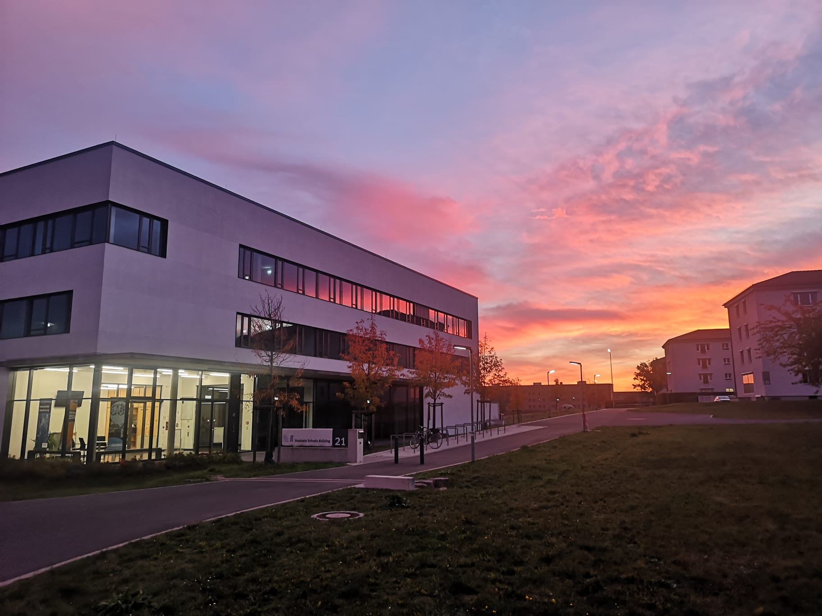

Slide 2
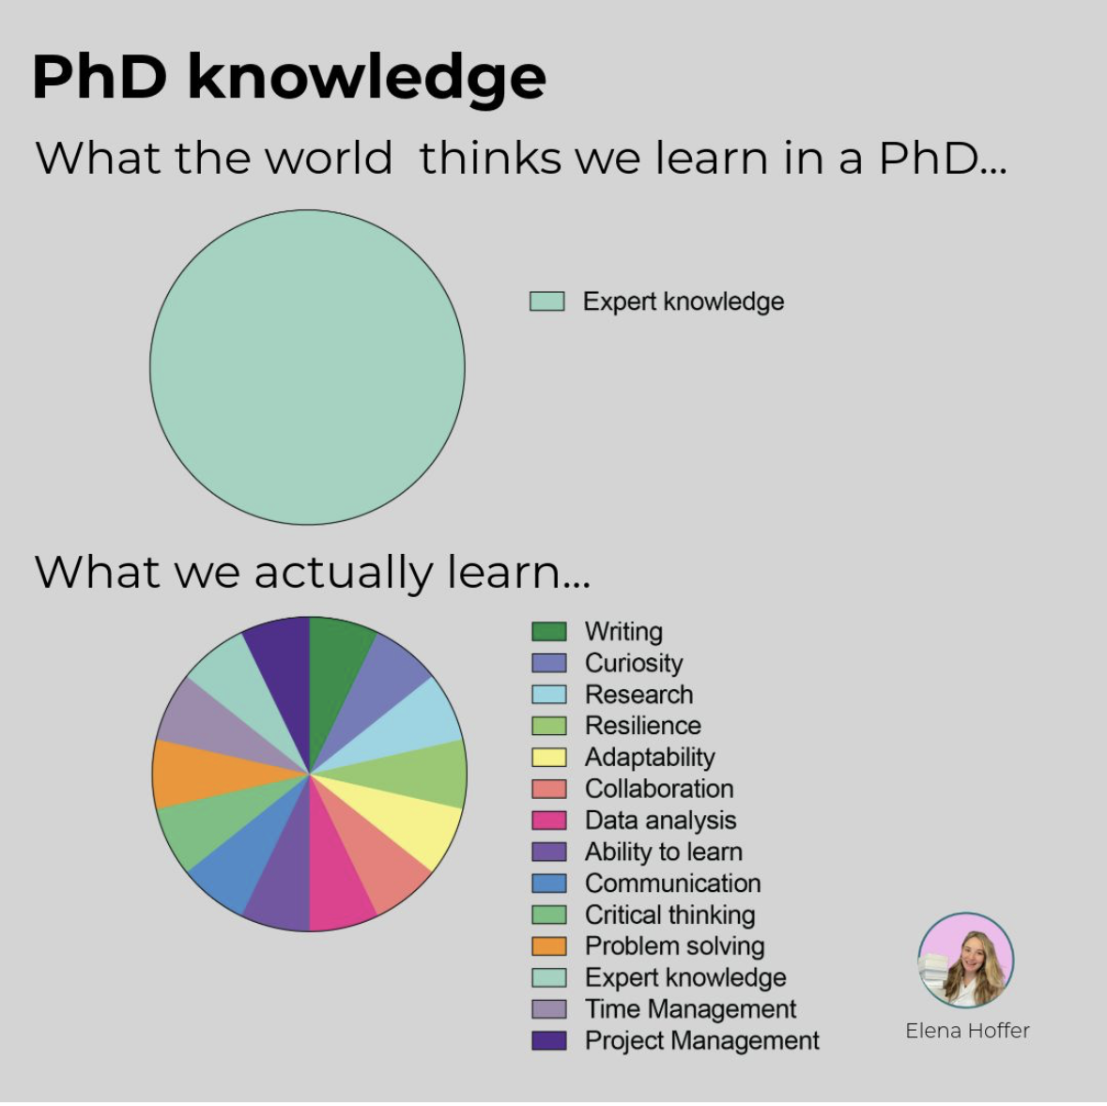
https://www.linkedin.com/in/elena-hoffer-?utm_source=share&utm_campaign=share_via&utm_content=profile&utm_medium=ios_app

Slide 3

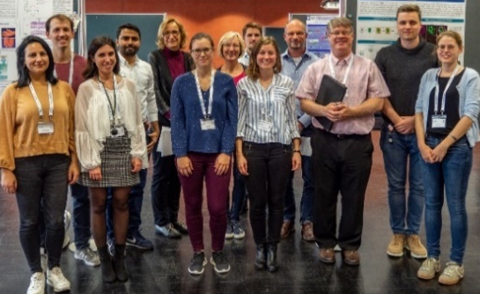
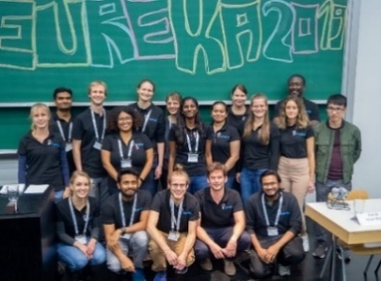
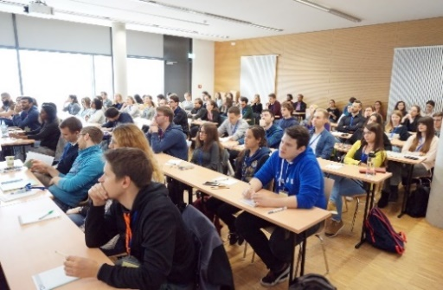
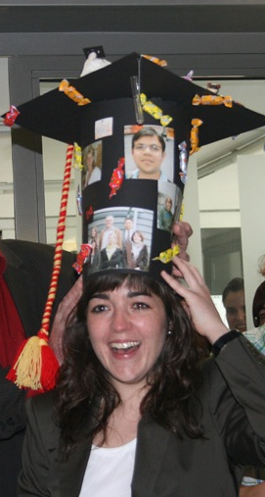
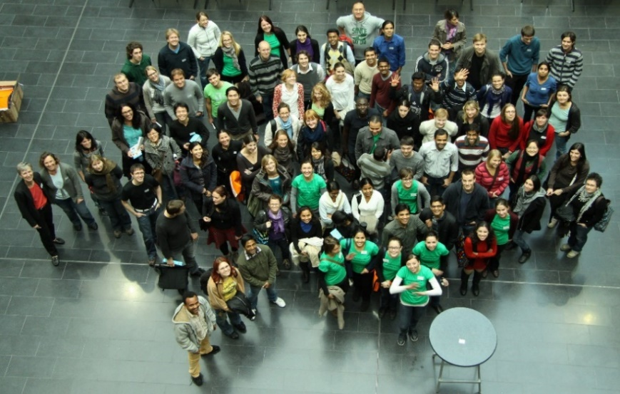
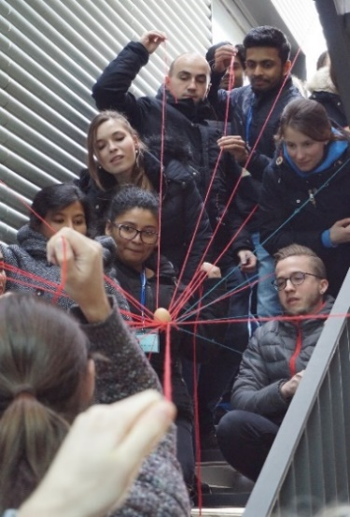
The Graduate School of Life Sciences
The Garduate School of Science and Technology
Structured Doctoral Training at the University of Würzburg
https://www.graduateschools.uni-wuerzburg.de/life-sciences/
@gslsuniwue.bsky.social
https://www.graduateschools.uni-wuerzburg.de/science-and-technology/

Slide 4
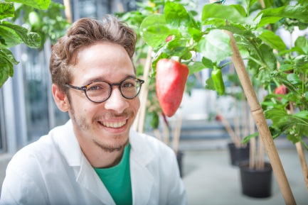
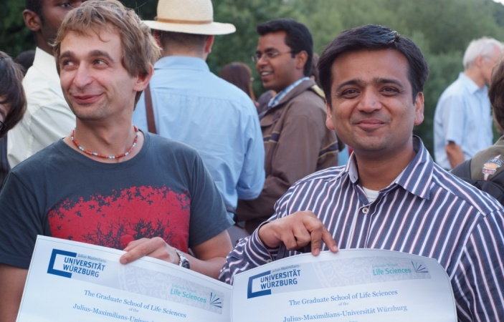
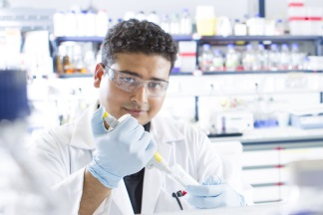
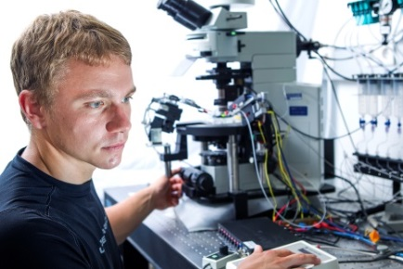
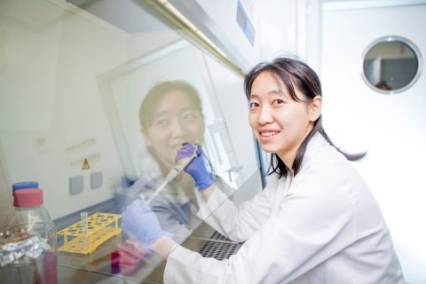
Outline
Structure of the GS
Regulations of the GS
- Path to graduation
- Admission vs. enrollment
- Thesis committee
- Idea behind the GS training program
Graduation requirements – the GS study book
Conflict management
Scientific and transferable skills courses
Activities and events

Slide 5
The GSLS - Structure

Slide 6
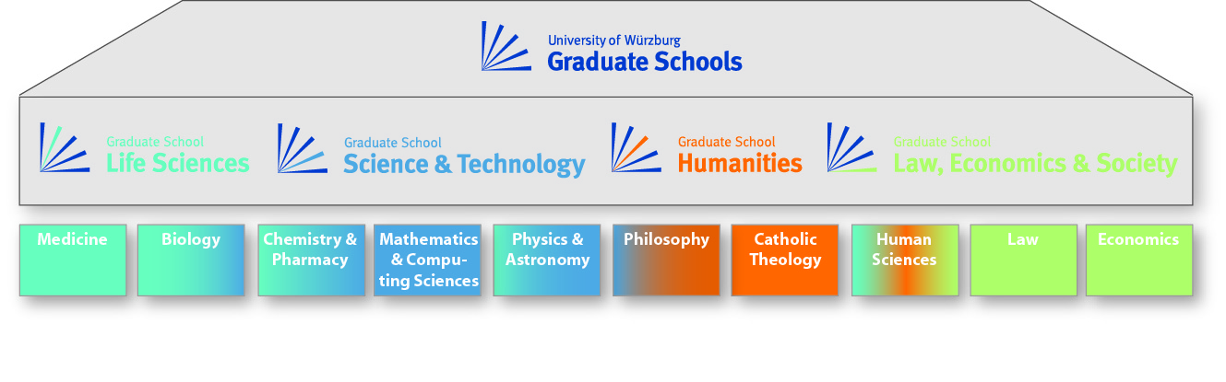
Why Graduate Schools ?
The Würzburg Model
    Platform for interdisciplinary approach
    Same criteria for all departments/faculties
    Thesis committee
    Structured training program
    Junior group leaders can be PIs

Slide 7

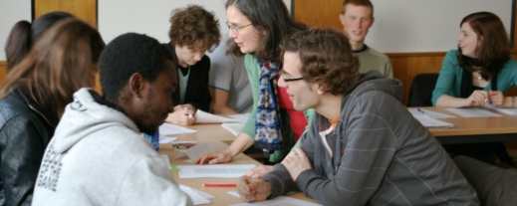
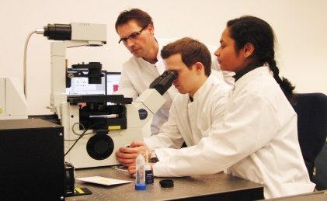
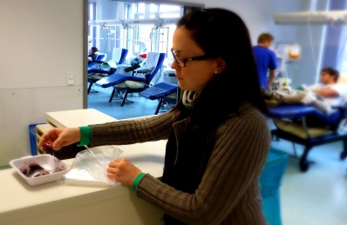
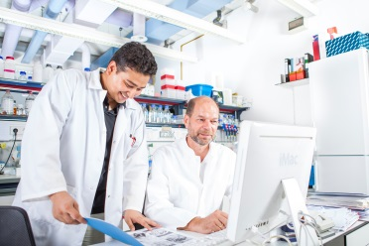
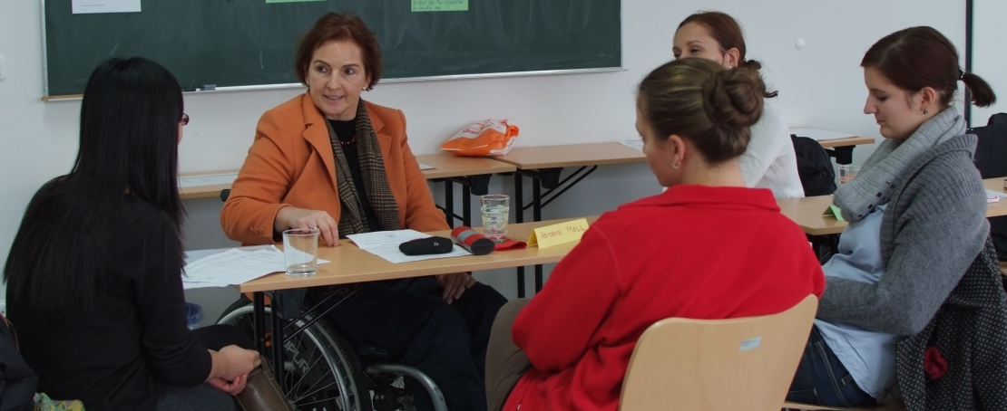
Programs of the GSLS/GSST
Doctoral phase
GSLS/GSST
MD phase
Postdoc phase

Slide 8
GSLS - Facts and Figures (October 2025)
Principal Investigators | 356 (301 w/o time limited)
Doctoral Researchers (Internationals ~ 44 %) (Females ~ 62 %) | 552
Medical Doctoral Researchers (Internationals ~ 8 %) (Females ~ 64 %) | 247
10/2025
Notes:
Statistik – Jennifer
Looks like we reached a kind of Plateau

Slide 9
Graduations in the GSLS (until October 2025)
 | PhD/Dr. rer. nat. | Dr. med.
Graduations in the GSLS since 2008 summa cum laude magna cum laude cum laude rite | 1138 211 (19%) 842 (74%) 81 (7%) 4 (0,4%) | 166 23 (14%) 134 (81%) 9 (5%) 0
Total: 128
Total: 120
Total: 78
Total: 90
Total: 85
Total: 58
Numbers
Year
Notes:
Jennifer
Absolute numbers
252 working days means every second working day a GSLS defense

Slide 10
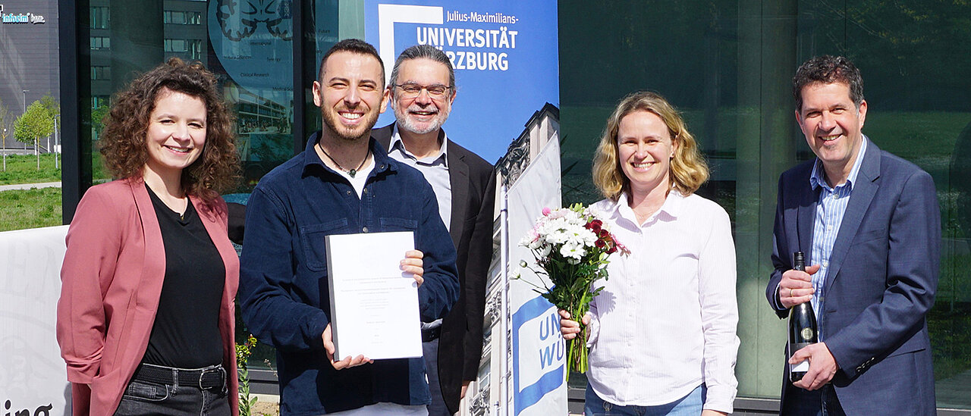
GSLS Celebrates its 1000th Doctorate
On April 12, 2024
Federico Ronchetti
(PI Prof. Thomas Schmitt) submitted the 1000th dissertation, focusing on the ecological and evolutionary biology of interactions between Hymenoptera insects and bacteria.
Federico Ronchetti (2nd from left) during the handover of his dissertation to the GSLS administrator, Eva Dallmann (left). Congratulating him are (from left) Dr. Stephan Schröder-Köhne (Managing Director of the Graduate Schools at the University of Würzburg), Dr. Jennifer Ritzer (Managing Director of the GSLS), and Professor Christian Wegener (Director of the GSLS).
https://www.uni-wuerzburg.de/aktuelles/einblick/single/news/gsls-feiert-1000-doktorarbeit/
Notes:
Great news and number Jennifer

Slide 11
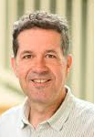
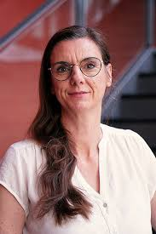
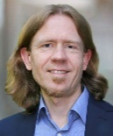
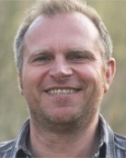
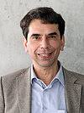
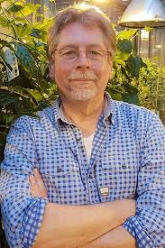
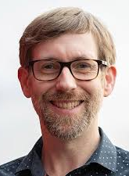
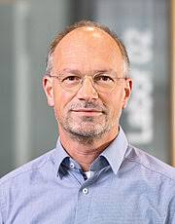
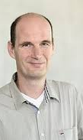
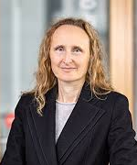
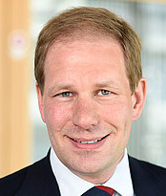
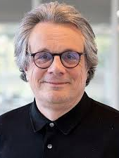
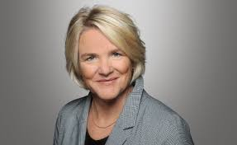
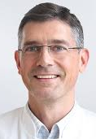
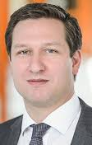
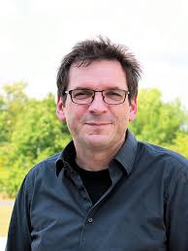
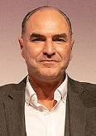

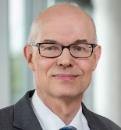
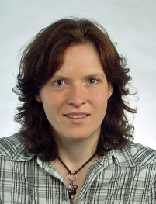
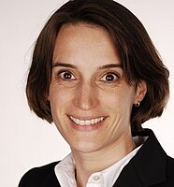
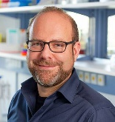
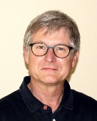
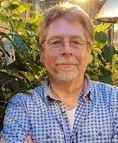
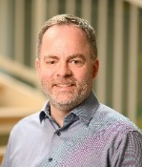
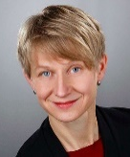
Organization of the GSLS
DRC
(Doctoral Researchers Council)
Executive Board, Dean: Christian Wegener
Vice Deans: Katrin Heinze, Matthias Gamer
Biology
Thomas Schmitt (vertritt Dekan)
Thomas Dandekar
Wolfgang Dröge-Laser
Keram Pfeiffer
Chemie
Alexander Buchberger (vertritt Dekan)
Utz Fischer
Leane Lehmann
Jürgen Seibel
Medizin
Peter Heuschmann (vertritt Dekan)
Carmen Villmann
Stefan Störk
Marcel Romanos
Physik
Peter M. Jakob (vertritt Jens Pflaum in Abwesenheit)
Humanwissen-schaften
Matthias Gamer (vertritt Dekan)
Faculties
Biomedicine
Speakers:
Heike Hermanns
Svenja Meierjohann
Torsten Blunk
Infection & Immunity
Speakers:
Georg Gasteiger
Franziska Faber
Oliver Kurzai
Integrative Biology
Speakers:
Wolfgang Rössler
Wolfgang Dröge-Laser
Christian Hof
Neuroscience
Speakers:
Carmen Villmann
Matthias Gamer
Grit Hein
Clinical Sciences
Speakers:
Peter Heuschmann
Stefan Störk
Marcel Romanos
Sections

Slide 12
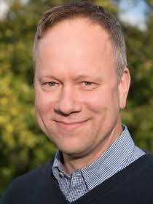
Organization of the GSST
DRC
(Doctoral Researchers Council)
Executive Board, Dean: Bert Hecht
Biology
Chemie
Physics and Astronomy
Physik
Mathematics and Computing Sciences
Faculties

Slide 13
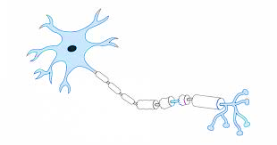
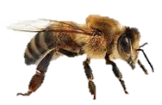




GSLS sections and programs
Clinical Neuroscience
Molecular Neuroscience
Neuroscience
Molecular Plant Biology
Behavioural Biology
Organismic Interaction & Ecology
Biodiversity & Evolution
RNA & Infection
Immunomodulation
Antiinfectives
Infection &
Immunity
GSLS
Integrative
Biology
Tumor Biology
Cardiovascular Sciences
Biofabrication
Molecular Biosciences
Developmental Biology
Biomedicine
Clinical
Sciences
Clinical Research
Clinical Epidemiology
Health Services Research
Faculties : Biology, Medicine, Chemistry & Pharmacy, Psychology, Physics

Slide 14
Outline
Structure of the GSLS
Regulations of the GSLS
- Thesis committee
- Path to graduation
- Admission vs. enrollment
- Idea behind the GSLS training program
Graduation requirements – the GSLS study book
Conflict management
Scientific and transferable skills courses
Activities and events

Slide 15
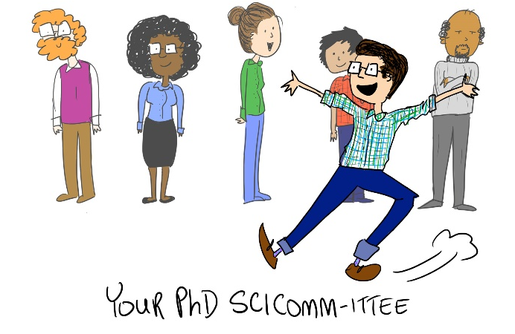
The Thesis Committee
Take advantage of your committee meetings !
Double-check your thesis committee with the GS
(contact: Katharina Bötsch)

Slide 16
The Thesis Committee
At least three supervisors
Primary and secondary supervisors have to be GS members from different departments
Third supervisor may come from another university,
also from abroad (input from extern)
A minimum of three different departments should be represented
Prerequisite (first or second supervisor) :
  First or second GS supervisor must be a
  Faculty member of one of the Natural Science Faculties of the University of Würzburg (Biology, Chemistry & Pharmacy, Physics, Mathematics & Computer Sciences )
  [OR be appointed as an examiner by one of those faculties]
  One GS member supervisor has to be habilitated or hold a permanent professorship
Take advantage of your committee meetings !
Double-check your thesis committee with the GS
(contact: Katharina Bötsch)

Slide 17
GS admission/enrollment process
German and International Master degree
Application for admission
(Open Campus)
Check by
GS Office
Admission meeting GS
Admission Letter
Enrollment at „Studierendenkanzlei“

Slide 18
Path to graduation in the GS
Admission to the GS
Initial admission letter admits you for 4 years (= 8 semesters of enrollment)
From the 5th year: extension of admission requires approval of thesis committee members
From the 6th year: extension of admission requires approval of Dean, as well thesis committee members
GSLS admission:
Extension 6th year:
Thesis Committee/Dean
Initial admission
Admission letter
Extension 5th year:
Thesis Committee
Year 1
Year 2
Year 3
Year 4
Year 5
Year 6
Start-up meeting
Annual meetings – permission to submit thesis at Final meeting
Thesis submission
and defense
Annual meetings
Regular meetings with the thesis committee
Start-up and annual meetings are mandatory for the first 6 semesters of the PhD and additionally a final meeting before submission

Slide 19
The difference between “GS admission”
and “enrollment at the university”
GS admission: obligatory until thesis submission
Thesis
submission
Initial admission
extension
Year 1
Year 2
Year 3
Year 4
Year 5
Obligatory
Optional
Optional
Enrollment at the university
Years 1-4 of your PhD:
Your initial GS admission is valid for 4 years corresponding to 8 semesters
→ You don´t need to extend your GS admission during the first 4 years of your PhD
→ BUT remember to renew your enrollment at the JMU each semester (“Rückmeldung“)
From the 5th year of your PhD:
GS admission: extension required every year
→ Your GS admission must be valid when you submit your thesis
Renewal of enrollment: NOT mandatory after the 6th semester

Slide 20
The difference between “GS admission”
and “enrollment at the university”
1. Admission to the GSLS
Admission to pursue the structured PhD within the GS (thesis commitee, training…)
Prerequisite: Initial GS „Admission Letter“ or approved extension of GS admission (from 5th year)
Responsible: initially GS Office; after the first 4 years: YOU!
Important date: Start of thesis project (as indicated in admission letter/in OpenCampus)
GS admission: obligatory until thesis submission
Thesis
submission
Initial admission
extension
Year 1
Year 2
Year 3
Year 4
Year 5
Obligatory
Optional
Optional
Enrollment at the university
2. Enrollment at the JMU
„Student status“ (student ID, semester ticket etc.)
Prerequisite: valid GS admission
Important dates: Deadlines for renewal of enrolment („Rückmeldung“)
→ YOU are responsible to pay the semester fee and enroll + re-enroll on time each semester !
→ Consider a direct debit („Lastschrift“)

Slide 21
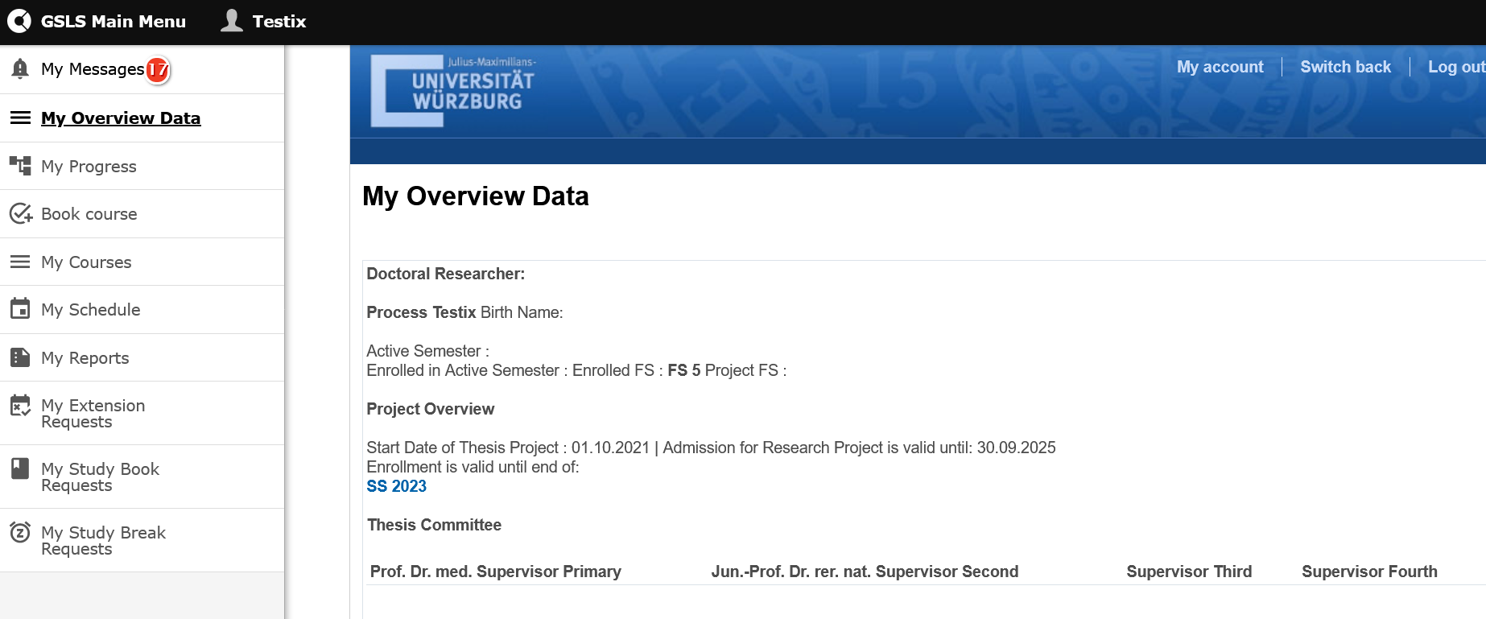
OpenCampus
electronic study book
https://gsls.cloud.opencampus.net/
Check the status of admission and enrollment

Slide 22
Do you have any questions?
Regulations of the GS

Slide 23
Outline
Structure of the GS
Regulations of the GS
- Path to graduation
- Admission vs. enrolment
- Thesis committee
- Idea behind the GSLS training program
Graduation requirements – the GS study book
Conflict management
Scientific and transferable skills courses
Activities and events

Slide 24


Challenges of Pursuing a PhD
Long Time Commitment: PhD programs typically last 3-7 years (average 4,3 years).
Research Uncertainty: Research can be unpredictable, leading to setbacks and frustrations.
Work-Life Balance: Balancing research, coursework, teaching responsibilities, and personal life can be challenging.
Isolation and Stress: PhD candidates may experience feelings of isolation and stress due to the intense workload and high expectations.
Funding Period: Securing funding for the entire duration of the PhD can be difficult, leading to financial stress and uncertainty.
https://www.researchgate.net/figure/Challenges-and-achievements-during-the-PhD-journey_tbl2_51215169
Notes:
Your contract ends: apply for unemployment benefit

Slide 25
Pursuing a PhD/Dr. rer. nat.: Structured Program vs. Individual Research
Aspect | Structured Program | Individual Research
Curriculum | Defined courses and seminars | Flexible, customized research plan
Timeline | Fixed, with regular milestones | Flexible, self-paced
Supervision | Frequent interactions with your mentors | Less frequent, focused guidance
Skill Development | Broad, interdisciplinary training | In-depth, specialized focus
Networking | High, through organized events and projects | Variable, depends on personal initiatives and your lab
Notes:
Pursuing a PhD/Dr. rer. nat.: Structured Program vs. Individual Research
Structured Program
Definition:
A pre-defined curriculum with specific courses, seminars, and a timeline.
Often includes collaboration with a research team or participation in a research school.
Goals:
Skill Development:
Gain a broad set of research skills through mandatory coursework.
Develop competencies in teaching, project management, and scientific communication.
Networking:
Build connections with peers, faculty, and industry professionals.
Participate in collaborative projects and conferences.
Timely Completion:
Structured timeline helps ensure the PhD is completed within a set timeframe.
Regular milestones and evaluations keep the research on track.
Individual Research
Definition:
A self-directed research project guided by a supervisor or a small supervisory team.
Greater flexibility in research direction and methodology.
Goals:
Deep Focus:
Opportunity to delve deeply into a specific research question or problem.
Foster innovation and original contributions to the field.
Autonomy:
Develop independent research skills and critical thinking.
Self-manage the project timeline and deliverables.
Personalized Learning:
Tailor the research experience to individual interests and career goals.
Flexible scheduling and pacing based on personal progress and discoveries.

Slide 26
Why Scientific Work is Paramount in a PhD, with the Structured Program as a Support
Scientific Work (Advancement of Knowledge, Skill Development, Critical Thinking, Problem-Solving)
YOUR Responsibility:
Commitment and Dedication
Active Participation in Research
Seeking Mentorship and Feedback
Continuous Learning and Development
GS - Structured Training Program (Guidance, Skill Enhancement, Balance, Flexibility)

Slide 27

https://www.linkedin.com/in/elena-hoffer-?utm_source=share&utm_campaign=share_via&utm_content=profile&utm_medium=ios_app

Slide 28





The GS Training Program
General idea
Individual research and training plan (“prescription”), adapted in discussion with the thesis committee
Scientific and Transferable Skills Training
Mentoring
Female GS doctoral researchers: MENTORING life sciences
(Mentee-mentor relationship, Workshop series, Network meetings)
→ now in cooperation with the Gender Equality Academy
Carrer center office of the JMU
University Hospital: Mentoring-Med

Slide 29






Career & Qualification Offers of
the Women’s Representative Office
Mentoring: for female doctoral students, mentoring, training, networking (duration one year, call for applications in autumn; participants must be fluent in german)
Postdoc & International: qualification during postdoc phase or habilitation, workshops, coaching, networking (duration one year, call for applications in autumn)
Women’s Leadership Program
for female (junior) professors and experienced working group leaders: Workshops on leadership, chair management, conflicts, positioning in power arenas, media and interview training, individual coaching, networking with alumnae, fireside chats
Gender Consulting Service for DFG-funded programs
primarily aimed at young female researchers who are actively involved in a DFG-funded collaborative project: workshops and training sessions on career development; for researchers of all genders: joint training courses, which address gender aspects
unifrauenbeauftragte@uni-wuerzburg.de Tel.: +49 931 31-85665 Klara-Oppenheimer-Weg 38, 97074 Würzburg Campus Hubland Nord

Slide 30


Mentoring – get inspired!
If you ask yourself
.. where your studies might lead you professionally
.. how to lay the groundwork for career success
then you are invited to join Mentoring Program!
In a nutshell:
alumni of the University of Würzburg pass on their practical professional experience
geared to students, graduates, and doctoral candidates
You have two different options:
  a one-time consultation
  a one-year “relay” program with a personal mentor
  ..in both cases you will have a specialist mentor at your side who will advise and accompany you - you create the exchange together and individually!
  Conctact and registration possibility
alumni@uni-wuerzburg.de, Phone: 0931-31-83150
https://go.uniwue.de/registrierung

Slide 31

Graduation requirements
- The Study Book -
Will be delivered as part of the “Welcome Pack“
Electronic pages for the study book are available on the GS Website
https://www.graduateschools.uni-wuerzburg.de/life-sciences/doctoral-researchers/forms-downloads/
Open Campus

Slide 32

Forms & Downloads at the
GS website
https://www.graduateschools.uni-wuerzburg.de/life-sciences/doctoral-researchers/forms-downloads/

Slide 33

Forms & Downloads at the
GS website

Slide 34

Graduation requirements
- Overview -
Open Campus
Annual progress reports (start-up meeting, annual committee meetings)
Research seminars (lab meeting, literature seminar, research training group)
Annual retreat / Summer School
One elective per term: Choice from large program of
    Lectures and methods courses
    Transferable skills courses
    Research stays abroad etc.
    Mandatory workshops (normally offered at the GSLS Welcome Days)
    Good Scientific Practice (everybody)
    Intercultural Communication (for those going for the “Ph.D.” degree)
Active participation in at least three international meetings
At least one first author publication (GSLS) or co-author publication (GSST) in international peer reviewed journal (shared first authorship is accepted as well)

Slide 35
Notes:
Christian
Unterstützung im strukturierten Programm notwendig
Angebot Retreats in Arbeitsgruppe
Eligible activities include, in particular:
Research stays in other laboratories, including international research visits
Specialized lectures and subject-specific courses
Training in additional skills, especially communication skills
Courses in research management, self-management, and leadership
Attendance of up to two interdisciplinary events outside the primary field of research within a three-year period, particularly in the areas of technology transfer/entrepreneurship and languages/cultural studies
Participation in teaching or scientific activities of the Graduate School of Science and Technology

Slide 36

OpenCampus
electronic study book
https://gsls.cloud.opencampus.net/
Upload annual reports
Automatic transfer of GS workshop certificates into your curriculum tree
Fill in information on meetings, other workshops, research stays etc.

Slide 37

OpenCampus
electronic study book
https://gsls.cloud.opencampus.net/
Notes:
Please check your entries reguarly and – your

Slide 38
OpenCampus
electronic study book
https://gsls.cloud.opencampus.net/
Study book and certificates of participation - uploaded in Open Campus and approved by GS (GS study program requirements).
The diploma supplement is created based on your entries. Please ensure they are entered carefully and in a consistent format.

Slide 39


Start-Up and Annual
Thesis Committee Meetings
Form template: Download at GSLS website
Meetings of your thesis committee should take place in person
  possible: by video conference, by phone, during conferences
Ask your committee members how they would like to structure the meeting
(e.g. prepare a presentation/report for the meeting and send it to the committee beforehand)
Establish your training program with your thesis committee
4th/5th year (“final“) meeting
Take advantage of your committee meetings !

Slide 40
Start-Up and Annual
Thesis Committee Meetings
Crucial opportunity for guidance & feedback from your mentor team
Aim: Maximize thesis success through open discussion
Share detailed insights into achievements and plans in advance
Provide your progress and successes to the mentor team before the meeting
Accepted formats: the official report form including a separate report, or a PowerPoint presentation
Upload the final version as a single PDF file to accompany your report
Prioritize in-person meetings for meaningful exchange
Online meetings: acceptable, but less effective
Ensure full committee participation
Arrange supplementary meetings for any absentees
Take advantage of your committee meetings !

Slide 41
Start-Up and Annual
Thesis Committee Meetings
✅ Summary Checklist
Write your report carefully before the meeting.
Share your materials with all mentors in advance.
You’re welcome to include a presentation or other supporting materials (optional).
We encourage in-person meetings whenever possible.
Make sure to fill out every required field on the form.
Complete the form together with your committee during the meeting.
Submit the fully completed and signed report afterwards.
If you need more time, request an extension via the
GS Main Menu.

Slide 42
Start-Up and Annual
Thesis Committee Meetings
Form template: Download at GS website
Meetings of your thesis committee should take place in person
  possible: by video conference, by phone, during conferences
Ask your committee members how they would like to structure the meeting
(e.g. prepare a presentation/report for the meeting and send it to the committee beforehand)
Establish your training program with your thesis committee
4th/5th year (“final“) meeting
Sign and upload your reports in OpenCampus under „My Reports“ in the GS Main Menu
Start-up meeting latest 3 months after admission
Annual meetings with committee are required for each year of your active research
Don´t ignore reminder emails from the GS. Get in touch with us if there are problems

Slide 43
Graduation in the GSLS - Reports
GS admission:
Initial admission
Admission letter
Extension 5th year:
Thesis Committee/Dean
Year 1
Year 2
Year 3
Year 4
Year 5
Start-up meeting
Annual meetings – permission to submit thesis at Final meeting
Thesis submission
and defense
Annual meetings
Regular meetings with the thesis committee
Start-up and annual meetings are mandatory for the first 6 semesters of the PhD and additionally a final meeting before submission
Annual Mentor Meetings: Success through insightful discussions and guidance.
Share what you’ve achieved and what you plan next
Exclusively online meetings may be less effective than in-person ones. In-person meetings are preferred

Slide 44

OpenCampus
My reports - Reminder
Reminder email:
If 3 months have passed since the admission letter issue date and no start-up report has been uploaded → to the doctoral candidate.
Always: Reminder of an upcoming Thesis Committee Meeting 4 weeks before the planned next meeting → to the doctoral candidate.
2 weeks after the planned next meeting → to the doctoral candidate.
6 weeks after the planned next meeting → to the doctoral candidate and primary supervisor.

Slide 45

GSLS Travel Fellowships
Funding for travel fellowships is based on the location of the meeting or activity attended:
Germany: up to 300 EUR
Europe/Overseas: up to 500 EUR
In total: up to 1.200 EUR until graduation
  Contact the GSLS Office if you have any questions
  (gsls-info@uni-wuerzburg.de)

Slide 46
Do you have any questions?
Graduation requirements of the GS

Slide 47
Outline
Structure of the GS
Regulations of the GS
- Path to graduation
- Admission vs. enrolment
- Thesis committee
- Idea behind the GSLS training program
Graduation requirements – the GS study book
Conflict management
Scientific and transferable skills courses
Activities and events

Slide 48
Conflict management in the GS

Slide 49

Supervision Agreement (see Welcome Pack)
Persons involved
Research and Training Plan
Obligations of Doctoral Researcher
Obligations of Supervisors
Compatibility of Research Work and Family Life
Observing the rules of Good Scientific Practice

Slide 50



How to proceed in conflict situations ?
Resolution of conflicts within your thesis committee
Contact the GS (GS office, GSLS or GSST Dean)
Contact the Doctoral Researchers Council (DRC)
Mental Health First Aiders (e.g. G. Blum-Oehler, K. Brandl)
„Konfliktberatungsstelle“ of the University of Würzburg
https://www.uni-wuerzburg.de/beschaeftigte/konfliktmanagement/konfliktberatungsstelle/
Hochschulambulanz für Psychotherapie, Marcusstraße 9-11
https://www.psychologie.uni-wuerzburg.de/hochschulambulanz/ueber-uns/team/
Psychotherapeutische Hochschulambulanz, Margarete-Höppel-Platz 1
https://www.ukw.de/en/psychiatry/outpatient-treatment/
External contact points
  Telefonseelsorge (phone counseling), Krisennetzwerk Unterfranken
  Crisis services in emergencies: Rescue service, police

Slide 51
How to proceed in conflict situations ?
Resolution of conflicts within your thesis committee
Contact the GSLS (GSLS office, GSLS Dean)
Contact the Doctoral Researchers Council (DRC)
„Konfliktberatungsstelle“ of the University of Würzburg
https://www.uni-wuerzburg.de/beschaeftigte/konfliktmanagement/konfliktberatungsstelle/

Slide 52







Doctoral Researchers’ Council (DRC)
Representation of doctoral students in the GSLS/GSST
Elected by doctoral students
Networking with other doctoral representations across Bavaria
and Germany
Organization of social events
  Pub Crawl
  Pub Quiz/ Trivia Night
  BBQ
@drcwuerzburg.bsky.social
@drcwuerzburg
@DoctoralResearchers Council (DRC)
Universität Würzburg
drc-gsls@uni-wuerzburg.de

Slide 53












Current Team
Pia
Anastasiya
Andrea
Salma
Peter
Samuel
Sukanya
Johanna
Harsha
Yigit
Infection and Immunity – Ecology – Behavioral Studies – Neurology – Virology – Experimental Biomedicine

Slide 54





Social Media
E-Mail: gsls-drc@uni-wuerzburg.de

Slide 55
Outline
Structure of the GS
Regulations of the GS
- Path to graduation
- Admission vs. enrolment
- Thesis committee
- Idea behind the GSLS training program
Graduation requirements – the GS study book
Conflict management
Scientific and transferable skills courses
Activities and events

Slide 56
Scientific and Transferable Skills Courses

Slide 57

The GSLS customizable training program
Study book overview

Slide 58
The GS customizable training program
The study program requires you to complete six “electives”
  Ideally, you will have visited at least 3 scientific courses and 3 transferable skills workshops
  Definition “Transferable skills”: General skills that go beyond the day-to-day requirements of your PhD project
„Good Scientific Practice“ is mandatory for all GSLS doctoral candidates
For the study program ‘PhD Life Sciences’ please note that the “Intercultural Communication” course is mandatory
Individual choice is encouraged!
Your thesis committee might recommend courses for you to take

Slide 59
The GS customizable training program
EARLY STAGE | According to your needs | FINAL STAGE
Good Scientific Practice | Scientific Writing and Publishing / Writing of Scientific Papers | Cover Letter & CV
Intercultural Communication | Supervising BSc and MSc Students | Job Interview
Poster Design & Presentation | Critical Reasoning and Logic | Introduction Biotech Industries
Oral Presentation | Purposeful Networking | Quality Management and Audit Biotech Industries
Academic Writing (for Beginners) | Improved Reading | Good Manufacturing Practice
EndNote for Scientists | Slide Writing | Good Clinical Practice
Literature Research Strategies for Scientists | Visual Communication of Science | EU Patent Law in Life Sciences
Networking at International Conferences |  | Grant Writing
Project management |  | Job Perspectives in Pharmaceutical Industry
Open Access and Copy Right in Science
Transferable Skills - Overview
Notes:
What are “transferable skills”?
General skills that go beyond the day-to-day requirements of your PhD project
„Dual use“: helpful for successful completion of PhD project and for future professional development

Slide 60
The GS customizable training program
“Scientific courses” – examples:
Courses offered by the GS
  Statistics courses (e.g. Basic Statistics, Introduction to R, Data Analysis with R)
  Scientific Image Processing and Analysis
  Advanced Image Analysis and Macro Programming
  Software Carpentry
External method courses or seminars
  project relevant
  duration: at least 1 SWS/week or 1.5 days
  certification/confirmation of participation required (or confirmation by supervisor)
Colloquia/lecture series, e.g.
  Biocenter colloquium, RNA seminar & Microbiology colloquium, Zoological colloq., RVZ colloquium, Clinical Medicine lecture series …

Slide 61

Booking of GS courses
Log in directly at OpenCampus https://gsls.cloud.opencampus.net/
Please use the Username you used during your admission
Do NOT create a new account

Slide 62

Booking of GS courses
Book a workshop
→ You will receive a booking confirmation by email

Slide 63

Booking of GS courses
Book a place on the waiting list
→ You will receive a booking confirmation for the waiting list by email
Moving up the waiting list
If you have moved up from the waiting list, you will receive an email
To accept that place you don’t have to do anything else
If you don’t want to accept the place, cancel it
Notes:
Courses have a limited amount of places
Registrations are on a first-come-first serve basis
If a course is fully booked, you are placed on the waiting list
Free places will be allocated according to the order on the waiting list

Slide 64


Booking of GS courses
Overview - “My courses”
Check your bookings on a regular basis
→ Are you still available?
→ Have you moved up on the waiting list?
→ Is your PI up-to-date?
→ Please also cancel your registration if you are on the waiting list and no longer wish to participate

Slide 65

Booking of GS courses
Cancellation of courses
You will receive a cancellation confirmation by email
The next person on the waiting list will move up to the list of participants
Cancellation period ends 10 days before the workshop
Less than 10 days: Please write an email to gsls-info@uni-wuerzburg.de and send your medical certificate or supervisor confirmation
If you just don’t show up, we will block you for 6 months from course bookings
Please also cancel your registration immediately even if you are on the waiting list and no longer wish to participate

Slide 66





Further training options at the JMU
Konfliktmanagement

Slide 67


Slide 68


Slide 71
Do you have any questions?
Course booking

Slide 72
Activities and events

Slide 73
Annual Activities and Events
  Welcome Days (for new GS doctoral researchers)
    18 – 20 November 2026
  Graduate Schools‘ Day
  July 2027
  GSLS Lecture Series „Clinical Medicine“
  In summer terms (please register via OpenCampus)
  EUREKA ! Symposium (international symposium organized by GSLS students)
  7 – 8 October 2026 (Rudolf Virchow Center, UKW)

Slide 74


Annual Activities and Events
  Welcome Days (for new GS doctoral researchers)
    18 – 20 November 2026
    2 times per year /depending on the number of new PhD candidates
    Excellent networking opportunities
    Detailed introduction to the GSLS
    What to expect from a PhD
    Short introductions to your PhD projects
    Varied offer of important workshops (Good Scientific Practice, Intercultural Communication)
    Social event (guided city tour and pub crawl with the DRC)
    Counts as “Retreat” for your study book if fully attended

Slide 75







Annual Activities and Events
      Each July: Graduate Schools Day
              Career session
              General-interest lecture
              Graduation ceremony
              Supervisor of the year
              Thai Chi Session
              Live music and dinner

Slide 76
Annual Activities and Events
GSLS Lecture Series “Clinical Medicine”
Takes place in the Summer Terms
Lecture series in English, fully accountable towards your GSLS curriculum (Scientific courses/lectures)
Highly recommended for anyone with interest in the interplay between
unmet medical needs and basic research
Topics in SS 2026:
e.g. psychiatric disorders, cancer treatment, antiviral therapies
When: Mondays, 4:15 - 5:45 pm (Start: April/May 2024)
Where: Rudolf Virchow Center (RVZ), Seminar Room 1st floor
(Josef-Schneider-Str. 2, Building no. 15)
Registration: via OpenCampus

Slide 77





EUREKA! 2026 Symposium
International symposium in the field of Life Sciences
Organized by the PhD students of the GSLS
Two-day symposium including:
  Talks by outstanding researcher speakers from Germany and abroad
  Talks by student speakers of the GSLS (including awards)
  Poster session (including awards)
  Image and essay writing contests
  Career session
Platform for young researchers to discuss their research, meet other PhD students, and gain valuable insights into the current developments in the field of Life Sciences
Get in contact with the sponsoring companies
Meet other researchers in your field!
Main/student speakers and career session

Slide 78

Keynote Speaker
Anna Stöckl
University of Konstanz, Germany
Field of research: Insect Behavior (Color recognition/foraging)
Marisa Karow
Friedrich-Alexander-Universität (FAU) Erlangen-Nürnberg, Germany
Field of research: Brain Organoids
Jost Enninga
Institut Pasteur, France
Field of research: Dynamics of Host Pathogen Interaction.
Prof. Dr. Seamus Holden
University of Warwick, UK
Field of research: Microbial Biophysics
Prof. Dr. Hildegard Büning
Medizinische Hochschule Hannover, Germany
Field of research: Gene Therapy and Viral Vector Engineering.
Lenka Bešše
Masaryk University, Czech
Field of research: Tumor Resistance to Therapy.
Prof Dr Felix Meissner
University of Bonn, Germany
Field of research: Mass Spectromotry Immune Signalling.

Slide 79

EUREKA! 2026 Symposium
  October 2027 (Rudolf Virchow Center, UKW)
          Want to get involved? eureka.symposium@uni-wuerzburg.de

Slide 80



Annual Activities and Events
- GSLS City Tours -
General City tour (Welcome Days)
The Prince-Bishops' Residence - The Palace of Palaces
UNESCO World Heritage - Court Garden
Guide: Dr. Antje Hansen
Registration: via Transferable Skills Website

Slide 81





The GSLS Office 2026
The whole process from GSLS registration to thesis submission
Doctoral researchers' registration
(foreign and domestic)
Katharina Bötsch
Phone +49 931 31-86595
katharina.boetsch@uni-wuerzburg.de
Thesis submission and the doctoral procedure
Eva Dallmann
Phone +49 931 31-87994
eva.dallmann@uni-wuerzburg.de
Heike Schrenk
Phone +49 931 31-84079
heike.schrenk@uni-wuerzburg.de
Medical doctoral researchers‘ registration
Luise Lesch
Phone: +49 931 31-89325
luise.lesch@uni-wuerzburg.de
General management
Dr. Jennifer Ritzer
Phone +49 931 31-83630
jennifer.ritzer@uni-wuerzburg.de
Scientific and transferable skills course program,
PostDoc Plus program
Dr. Juliane Fiebig
Phone +49 931 31-80145
juliane.fiebig@uni-wuerzburg.de
IT Management
Venkatesh Parayitam
Phone +49 931 31-80838
venkatesh.parayitam@uni-wuerzburg.de
Office manager
Barbara Valin
Phone +49 931 31-85509
barbara.valin@uni-wuerzburg.de
Notes:
Christian

Slide 82

Graduate Schools Building
Campus Hubland North
Library
Doc club
Think tanks
Seminar
rooms
Offices
Welcome center
Lecture hall
Exhibition hall

Slide 83

Thanks for your attention!
https://www.graduateschools.uni-wuerzburg.de/life-sciences/
https://www.graduateschools.uni-wuerzburg.de/science-and-technology/
GSLS - Graduate School of Life Sciences Würzburg (@gslsuniwue.bsky.social) — Bluesky

